Slide 1

8085 MICROPROCESSOR
(UNIT-1)
(SUB: Microprocessor and Interfaces)
PREPARED BY:
ER. MOHIT MISHRA
ASSOCIATE PROFESSOR
COMPUTER SCIENCE DEPARTMENT
Notes:
HIIIIIIIIIIIIIIIIIIIIIIIIIIIIIIIIIIIIIIII

Slide 2
Contents
Pin Diagram of 8085
Programming Model of 8085
The 8085 Bus Organization
Microprocessor 8085 Architecture
Demultiplexing of Buses

Slide 3
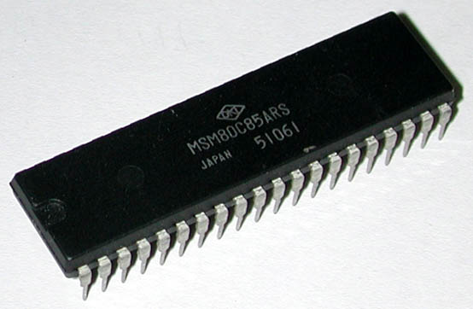
Introduction to 8085
It was introduced in 1976.
It is 8-bit microprocessor.
Its actual name is 8085 A.
It is single NMOS device.
Its dimensions are
164 mm x 222 mm.
It is having 40 pins Dual-Inline-Package (DIP).

Slide 4
Introduction to 8085
It has three advanced versions:
  8085 AH
  8085 AH2
  8085 AH1
These advanced versions are designed using HMOS technology.

Slide 5
Introduction to 8085
The advanced versions consume 20% less power supply.
The clock frequencies of 8085 are:
  8085 A 3 MHz
  8085 AH 3 MHz
  8085 AH2 5 MHz
  8085 AH1 6 MHz

Slide 6
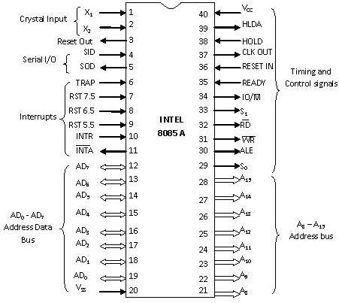
Pin Diagram of 8085

Slide 7
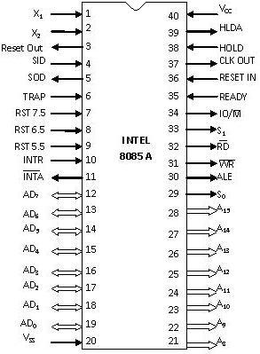
V_{SS} and V_{CC}
Pin 20 (Input) and Pin 40 (Input)
+5V power supply is connected to V_{CC}.
Ground signal is connected to V_{SS}.

Slide 8
X₁ & X₂
Pin 1 and Pin 2 (Input)
These are also called Crystal Input Pins.
8085 can generate clock signals internally.
To generate clock signals internally, 8085 requires external inputs from X₁ and X₂.

Slide 9
AD₀ – AD₇
Pin 19-12 (Bidirectional)
These pins serve the dual purpose of transmitting lower order address and data byte.
During 1st clock cycle, these pins act as lower half of address.
In remaining clock cycles, these pins act as data bus.
The separation of lower order address and data is done by address latch.

Slide 10
A₈ – A₁₅
Pin 21-28 (Unidirectional)
These pins carry the higher order of address bus.
The address is sent from microprocessor to memory.
These 8 pins are switched to high impedance state during HOLD and RESET mode.

Slide 11
ALE
Pin 30 (Output)
It is used to enable Address Latch.
It indicates whether bus functions as address bus or data bus.
If ALE = 1 then
  Bus functions as address bus.
If ALE = 0 then
  Bus functions as data bus.

Slide 12
S₀ and S₁
Pin 29 (Output) and Pin 33 (Output)
S₀ and S₁ are called Status Pins.
They tell the current operation which is in progress in 8085.
S₀ | S₁ | Operation
0 | 0 | Halt
0 | 1 | Write
1 | 0 | Read
1 | 1 | Opcode Fetch

Slide 13
IO/M
Pin 34 (Output)
This pin tells whether I/O or memory operation is being performed.
If IO/M = 1 then
  I/O operation is being performed.
If IO/M = 0 then
  Memory operation is being performed.

Slide 14
IO/M
Pin 34 (Output)
The operation being performed is indicated by S₀ and S₁.
If S₀ = 0 and S₁ = 1 then
  It indicates WRITE operation.
If IO/M = 0 then
  It indicates Memory operation.
Combining these two we get Memory Write Operation.

Slide 15
Table Showing IO/M, S₀, S₁ and Corresponding Operations
Operations | IO/M | S₀ | S₁
Opcode Fetch | 0 | 1 | 1
Memory Read | 0 | 1 | 0
Memory Write | 0 | 0 | 1
I/O Read | 1 | 1 | 0
I/O Write | 1 | 0 | 1
Interrupt Ack. | 1 | 1 | 1
Halt | High Impedance | 0 | 0

Slide 16
RD
Pin 32 (Output)
RD stands for Read.
It is an active low signal.
It is a control signal used for Read operation either from memory or from Input device.
A low signal indicates that data on the data bus must be placed either from selected memory location or from input device.

Slide 17
WR
Pin 31 (Output)
WR stands for Write.
It is also active low signal.
It is a control signal used for Write operation either into memory or into output device.
A low signal indicates that data on the data bus must be written into selected memory location or into output device.

Slide 18
RESET IN and RESET OUT
Pin 36 (Input) and Pin 3 (Output)
RESET IN:
  It is used to reset the microprocessor.
  It is active low signal.
  When the signal on this pin is low for at least 3 clocking cycles, it forces the microprocessor to reset itself.

Slide 19
RESET IN and RESET OUT
Pin 36 (Input) and Pin 3 (Output)
Resetting the microprocessor means:
  Clearing the PC and IR.
  Disabling all interrupts (except TRAP).
  Disabling the SOD pin.
  All the buses (data, address, control) are tri-stated.
  Gives HIGH output to RESET OUT pin.

Slide 20
RESET IN and RESET OUT
Pin 36 (Input) and Pin 3 (Output)
RESET OUT:
  It is used to reset the peripheral devices and other ICs on the circuit.
  It is an output signal.
  It is an active high signal.
  The output on this pin goes high whenever RESET IN is given low signal.
  The output remains high as long as RESET IN is kept low.

Slide 21
SID and SOD
Pin 4 (Input) and Pin 5 (Output)
SID (Serial Input Data):
  It takes 1 bit input from serial port of 8085.
  Stores the bit at the 8th position (MSB) of the Accumulator.
  RIM (Read Interrupt Mask) instruction is used to transfer the bit.

Slide 22
SID and SOD
Pin 4 (Input) and Pin 5 (Output)
SOD (Serial Output Data):
  It takes 1 bit from Accumulator to serial port of 8085.
  Takes the bit from the 8th position (MSB) of the Accumulator.
  SIM (Set Interrupt Mask) instruction is used to transfer the bit.

Slide 23
Interrupt Pins
Interrupt:
  It means interrupting the normal execution of the microprocessor.
  When microprocessor receives interrupt signal, it discontinues whatever it was executing.
  It starts executing new program indicated by the interrupt signal.
  Interrupt signals are generated by external peripheral devices.
  After execution of the new program, microprocessor goes back to the previous program.

Slide 24
Five Hardware Interrupts in 8085
TRAP
RST 7.5
RST 6.5
RST 5.5
INTR

Slide 25
Classification of Interrupts
Maskable and Non-Maskable
Vectored and Non-Vectored
Edge Triggered and Level Triggered
Priority Based Interrupts

Slide 26
TRAP
Pin 6 (Input)
It is an non-maskable interrupt.
It has the highest priority.
It cannot be disabled.
It is both edge and level triggered.
It means TRAP signal must go from low to high.
And must remain high for a certain period of time.
TRAP is usually used for power failure and emergency shutoff.

Slide 27
RST 7.5
Pin 7 (Input)
It is a maskable interrupt.
It has the second highest priority.
It is positive edge triggered only.
The internal flip-flop is triggered by the rising edge.
The flip-flop remains high until it is cleared by RESET IN.

Slide 28
RST 6.5
Pin 8 (Input)
It is a maskable interrupt.
It has the third highest priority.
It is level triggered only.
The pin has to be held high for a specific period of time.
RST 6.5 can be enabled by EI instruction.
It can be disabled by DI instruction.

Slide 29
RST 5.5
Pin 9 (Input)
It is a maskable interrupt.
It has the fourth highest priority.
It is also level triggered.
The pin has to be held high for a specific period of time.
This interrupt is very similar to RST 6.5.

Slide 30
INTR
Pin 10 (Input)
It is a maskable interrupt.
It has the lowest priority.
It is also level triggered.
It is a general purpose interrupt.
By general purpose we mean that it can be used to vector microprocessor to any specific subroutine having any address.

Slide 31
INTA
Pin 11 (Output)
It stands for interrupt acknowledge.
It is an out going signal.
It is an active low signal.
Low output on this pin indicates that microprocessor has acknowledged the INTR request.

Slide 32
READY
Pin 35 (Input)
This pin is used to synchronize slower peripheral devices with fast microprocessor.
A low value causes the microprocessor to enter into wait state.
The microprocessor remains in wait state until the input at this pin goes high.

Slide 33
HOLD
Pin 38 (Input)
HOLD pin is used to request the microprocessor for DMA transfer.
A high signal on this pin is a request to microprocessor to relinquish the hold on buses.
This request is sent by DMA controller.
Intel 8257 and Intel 8237 are two DMA controllers.

Slide 34
HLDA
Pin 39 (Output)
HLDA stands for Hold Acknowledge.
The microprocessor uses this pin to acknowledge the receipt of HOLD signal.
When HLDA signal goes high, address bus, data bus, RD, WR, IO/M pins are tri-stated.
This means they are cut-off from external environment.

Slide 35
HLDA
Pin 39 (Output)
The control of these buses goes to DMA Controller.
Control remains at DMA Controller until HOLD is held high.
When HOLD goes low, HLDA also goes low and the microprocessor takes control of the buses.

Slide 36
PROGRAMMING MODEL OF 8085 MICROPROCESSOR

Slide 37
Accumulator (8-bit) | Flag Register (8-bit)
B (8-bit) | C (8-bit)
D (8-bit) | E (8-bit)
H (8-bit) | L (8-bit)
Stack Pointer (SP) (16-bit)
Program Counter (PC) (16-bit)
S | Z |  | AC |  | P |  | CY
8- Lines
Bidirectional
16- Lines
Unidirectional

Slide 38
Six general-purpose registers
  B, C, D, E, H, L
  Can be combined as register pairs to perform 16-bit operations (BC, DE, HL)
Accumulator – identified by name A
  This register is a part of ALU
  8-bit data storage
  Performs arithmetic and logical operations
  Result of an operation is stored in accumulator

Slide 39
Flag Register
  This is also a part of ALU
  8085 has five flags named
    Zero flag (Z)
    Carry flag (CY)
    Sign flag (S)
    Parity flag (P)
    Auxiliary Carry flag (AC)

Slide 40
These flags are five flip-flops in flag register
Execution of an arithmetic/logic operation can set or reset these flags
Condition of flags (set or reset) can be tested through software instructions
8085 uses these flags in decision-making process

Slide 41
Program Counter (PC)
  A 16-bit memory pointer register
  Used to sequence execution of program instructions
  Stores address of a memory location
    where next instruction byte is to be fetched by the 8085
  when 8085 gets busy to fetch current instruction from memory
    PC is incremented by one
    PC is now pointing to the address of next instruction

Slide 42
Pointer Register
  a 16-bit memory pointer register
  Points to a location in Stack memory
  Beginning of the stack is defined by loading a 16-bit address in stack pointer register

Slide 43
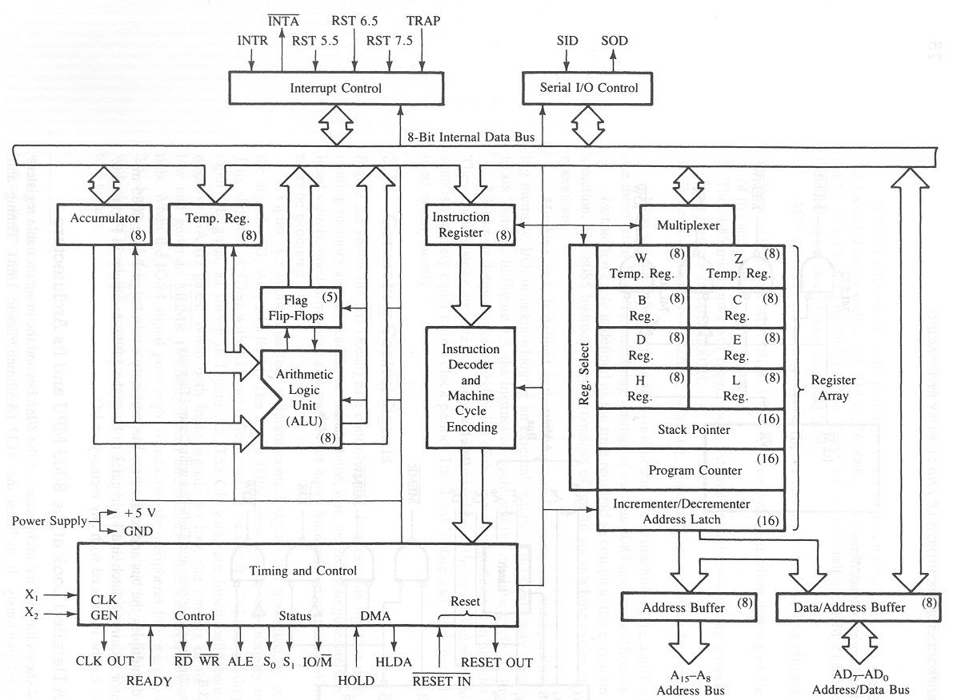
Microprocessor Architecture 8085

Slide 44
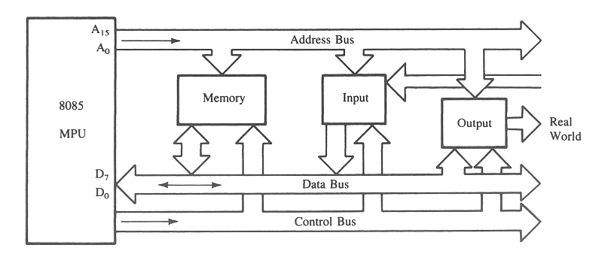
The 8085 Bus Organization
The 8-bit 8085 CPU (or MPU – Micro Processing Unit) communicates with the other units using a 16-bit address bus, an 8-bit data bus and a control bus.

Slide 45
The 8085 Bus Structure
Address Bus
  Consists of 16 address lines: A₀ – A₁₅
  Operates in unidirectional mode: The address bits are always sent from the MPU to peripheral devices, not reverse.
  16 address lines are capable of addressing a
  total of 2¹⁶ = 65,536 (64k) memory locations.
  Address locations: 0000 (hex) – FFFF (hex)

Slide 46
The 8085 Bus Structure
Data Bus
  Consists of 8 data lines: D₀ – D₇
  Operates in bidirectional mode: The data bits are sent from the MPU to peripheral devices, as well as from the peripheral devices to the MPU.
  Data range: 00 (hex) – FF (hex)
Control Bus
  Consists of various lines carrying the control signals such as read / write enable, flag bits.

Slide 47
Demultiplexing AD7-AD0
  From the above description, it becomes obvious that the AD7– AD0 lines are serving a dual purpose and that they need to be demultiplexed to get all the information.
  The high order bits of the address remain on the bus for three clock periods. However, the low order bits remain for only one clock period and they would be lost if they are not saved externally. Also, notice that the low order bits of the address disappear when they are needed most.
  To make sure we have the entire address for the full three clock cycles, we will use an external latch to save the value of AD7– AD0 when it is carrying the address bits. We use the ALE signal to enable this latch.

Slide 48
Demultiplexing AD7-AD0
8085
A15-A8
ALE
AD7-AD0
Latch
A₇- A₀
D₇- D₀
  Given that ALE operates as a pulse during T1, we will be able to latch the address. Then when ALE goes low, the address is saved and the AD7– AD0 lines can be used for their purpose as the bi-directional data lines.

